Slide 1
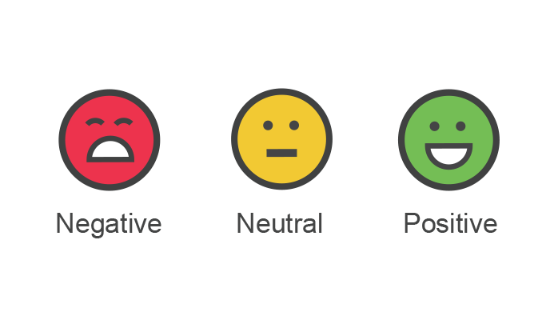
Movie Review Sentiment Analyzer
-By Ananya Srivastava

Slide 2
Index
Problem Defination
Data Defination And Gathering
Data Dictionary
EDA
Data Cleaning
Data Transformation
Machine Learning/Algorithm
Tuning
Deployment

Slide 3
Problem Defination
To perform sentiment analysis on the reviews of the given movies and output the general public’s outlook towards that movie.
This problem has been modelled as a B2C solution.It can help you to select a good movie to watch by comparing the reviews of different movies given by users on Rotten Tomatoes.
This model can be used by online video-on-demand services like Hotstar, Netflix , Hulu to facilitate their customers in selection of movies,much similar to Flipkart’s product-reviews.

Slide 4
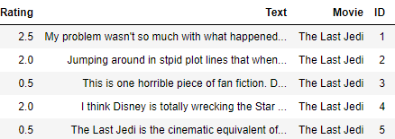
Data Defination And Gathering
The dataset has been downloaded from Kaggle [https://www.kaggle.com/jonsteve/user-reviews-of-16-movies-on-rotten-tomatoes]. It lists reviews of 16 Hollywood movies, given by users on Rotten Tomatoes.
Shape:
There are 10384 reviews and 4 columns.

Slide 5
Data Dictionary
Column Name | Data Type | Description | Example
Rating | Float | The number of stars(out of 5) given by the user for the movie. | 5.0
Text | String | The textual review given by the user for the movie. | Terrible movie. Depressing with massive plot holes.
Movie | String | The name of the movie for which the review is given | 'Coco'
ID | String | Serial number associated with that movie | 522

Slide 6
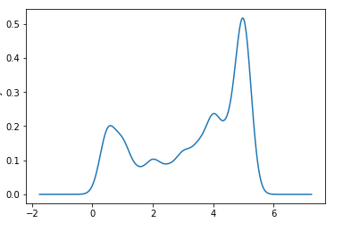
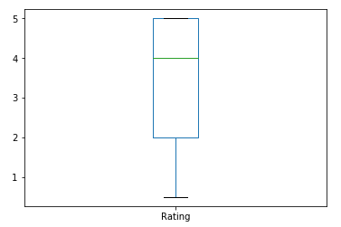
Data Dictionary
Column Name | Mean | Median | Mode | Min | Max | Standard Deviation | Modality
Rating | 3.36 | 4.0 | 5.0 | 0.5 | 5.0 | 1.636 | Pentamodal
Density Curve For Ratings
rating box plot

Slide 7
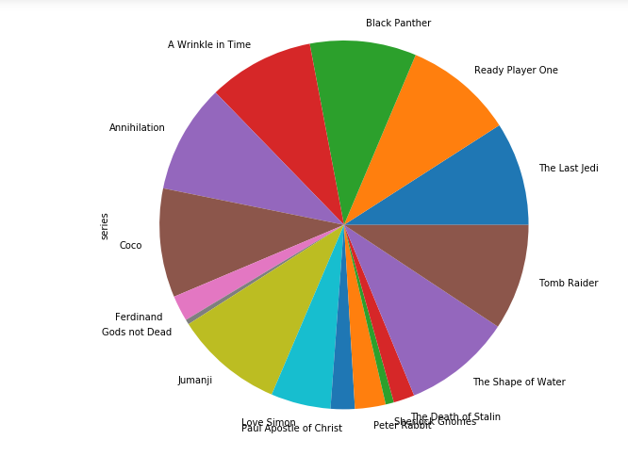
EDA
I first made a pie chart for to get an idea whether I have same no. of reviews for all the movies.As can be seen clearly seen on the right, the reviews were unevenly distributed amongst the movies.
I also made density curves of the ratings of each movie to get an indication of liked(or disliked) the movie was.The skewness of the graph revealed the likabilty of the movie based on Ratings.
A well recieved movie, like “Coco” has a right skewed graph because most users gave it more than 4 stars rating.Conversely, a badly recieved movie would be left skewed.
Our median for Ratings was found out to be 4.

Slide 8
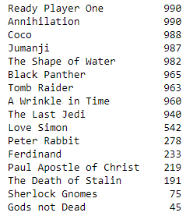
EDA
After analyzing the pie chart for the no. of reviews for each movie, and concluding that 'the reviews were unevenly distributed amongst the movies', I proceeded to find the exact number of reviews for each movie using value_counts method for the Movie column.As you can see on your right, movies of action genre, backed by big banners got the most no. of reviews. I was able to deduce this due to the domain knowledge I possess for this data.
'Gods not Dead' and 'Sherlock Gnomes' got relatively low number of reviews('Gods not Dead' got 4.5% of the reviews that Ready Player One got) but I have decided to keep the reviews for these moviews as I understand that a user might prefer to be guided by a less number of reviews in his/her selection of movie, than to have no reviews(and/or their sentiment analysis) to go through.

Slide 9
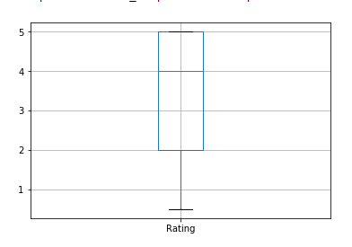
EDA
I made a box plot of all the ratings to check for the presence of outliers.I was fortunate enough to not have any outliers in my Ratings column.
I made the following deductions from this box plot
Minimum value is 0.5
Maximum value is 5.0
25 percentile is at 2.0
50 percentile(median) is at 4.0
75 percentile is at 5.0

Slide 10
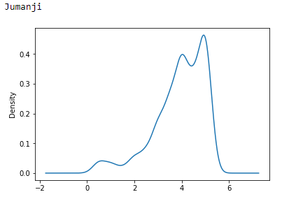
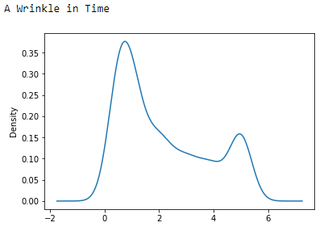
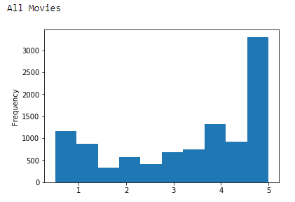
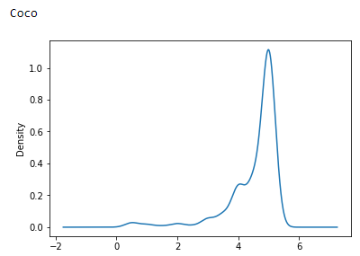
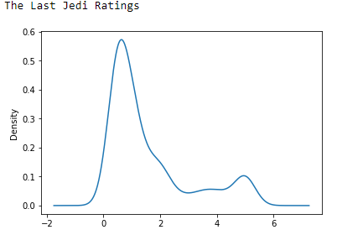
EDA

Slide 11
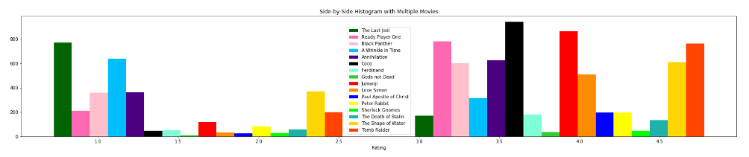
EDA
Movie wise rating Histogram
This histogram shows the frequency of different ratings for each movie in the dataset. I have chosen to not normalize it and keep the frequency count as my y axis. On the x axis, we have the ratings for the movies.The bars associated with ratings of each movie are placed side-by-side. To do this, we create a list of the ratings for each movie, and then pass this into the plt.hist function call as a list of lists. We have to specify different colors to use for each movie and a label so we can tell them apart. We used the plt.legend() function to show the legend also.

Slide 12
Data Cleaning
df['ID']=df['ID'].astype({'ID':'object'})
df['Text']=df['Text'].str.replace('stpid','stupid')
It should be noted that the data had been maintained in an orderly fashion.Hence much work wasn't needed in this phase.
The only two changes that I introduced were to change the data type of ID column from float to object and replaced a misspelt word with its correct spelling.

Slide 13
Data Transformation
df['Sentiment'] = 0
movieNames=[]
avgRating=[]
posPercent=[]
negPercent=[]
neuPercent=[]
I introduced a new column 'Sentiment' which would keep a score of sentiment. I intialized it with 0 for all records. I also created the lists on the left side which would later be used to create a new csv which would hold movie-centric version of the data which we had been provided with

Slide 14
Machine Learning/Algorithm
Sentiment Analysis also known as Opinion Mining is a field within Natural Language Processing (NLP) that builds systems that try to identify and extract opinions within text.For my project, I needed only to perform polarity classification.
I used standard Sentiment Analysis as it fit the bill for me when it came to my expectations from my model, which was to simply classify a given review either as positive or negative only.
I chose to perform automatic sentiment analysis.I modelled the sentiment analysis task as a classification problem where a classifier is fed with a text and returns the corresponding category, e.g. positive or negative.
I chose to vectorize using TF-IDF(Term Frequency - Inverse Document Frequncy) vectorizer.The first step in a machine learning text classifier is to transform the text into a numerical representation, usually a vector.In TF-IDF word frequency lowers the value if it present in more number of documents, which is useful in diminishing the importance of stop-words.TF-IDF are word frequency scores that try to highlight words that are more interesting, e.g. frequent in a document but not across documents.

Slide 15
Machine Learning/Algorithm
I chose to use SVM(Support Vector Machine) algorithm for classification as it is non-probablistic and it works well on non-normailzed data sets. Naturally, I couldn't normalize word frequencies, hence there wasn't a shred of doubt in my mind about choosing a non-probablistic.
Other good algorithms that I considered for my job were Deep Learning and Random Forest Classifier.However, there were other limitations to them.
Deep Learning uses neural networks, which mimic the functioning of the human brain.However, I felt that ,as a beginner, it might not be suitable to work with an algorithm whose which is a black box i.e. inner functioning are not known to me.
Random Forest consists of a large number of individual decision trees that operate as an ensemble.It also works well on non-normalized and particularly big data sets, like the ones I have used(25000 reviews in the training model), but I am not overtly familiar with desicion trees.

Slide 16

Tuning
I performed Parameter Tuning first on my vectorizer.I maximized the range of words I was considering by lowering min_df and increasing max_df. However, at the same time I decreased the max_features to 2000 so as only the features of most importance are considered.This helped me to avoid overfitting of my data.
I performed Parameter Tuning on my SVM. I chose SVC(Support Vector Classifier) as mine was a classification problem.I chose the kernal to be linear as my problem was linearly seprable(i.e. either positive(1) or negative(0)). The fit method of SVC class is called to train the algorithm on the training data, which is passed as a parameter to the fit method.

Slide 17
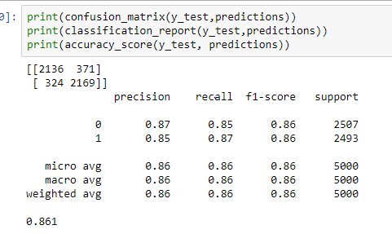
Tuning

Slide 18
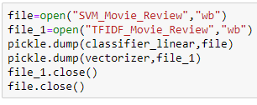
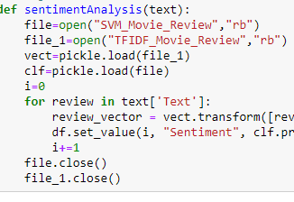
Tuning
After training, I pickled the classifier as well as the vectorizer in different files so that I can use them in another Juypter Notebook without wasting time where my model may have to re-learn on every re-lanch.
I dumped this pickle onto where my rottenTomatouserreviews and used them first to vectorize the incoming review and to predict the result using my trained model.Accordingly, an appropriate label was assigned to that review, wherein 1 denoted a positive review and 0 a neagitive review.

Slide 19
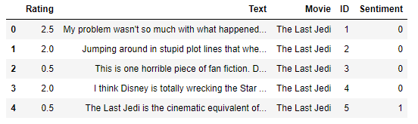
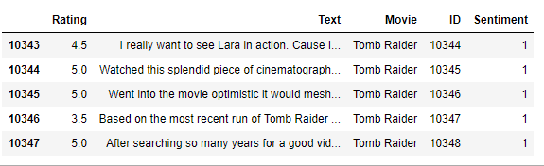
Tuning
On Your Left are snippets of the results of prediction of the reviews, performed by my model. The results, as analyzed by me manully, were upto my satisfaction. It may be noted however that my model is unable to correctly predict sarcastic reviews as evident in the fifth review of my reviews dataset.
From my result I can hence mathematically calculate the percentage of negative and positive reviews and gain an outlook on the general perspective about a particular movie.

Slide 20
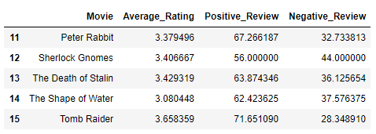
Tuning
On your left is the final result of my training model and its application, which is in accordnce to my requirments . The user can just input the movie name and get the average rating as well as percantage of people and negative reviews recieved by the movie, which can facilitate them in selection of a movie better.

Slide 21
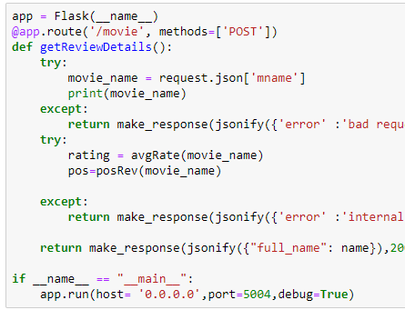
Deployment
I deployed the model by building a REST API (Representational State Transfer Application Programming Interface).An API facilitates the softwares at backend to communicate with the software at front.
I chose to build a REST API as it returns JSON objects, which is easy to integrate in a modern website as most sites ,nowadays use JavaScript on the front-end and Node.Js and Express.Js on the backend
I run this python script on right to build a server on my own computer and I can communicate with this server using Postman for demonstration purposes.

Slide 22
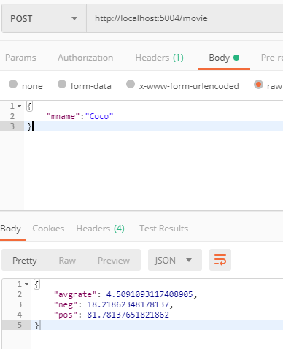
Deployment
On your left is a snippet of Postman API. we first started our server on our own device(hence the localhost in the url of the request) and we sent a JSON object with the property “mname” .Accordingly , on successful completion of our request , we responded with a JSON object which gives the average rating and percentage of reviews that were positive and negative.

Slide 23

Thank You!!

